Slide 1



CLASS PROJECT ON ALGORITHMS
FLOWCHART

Slide 2

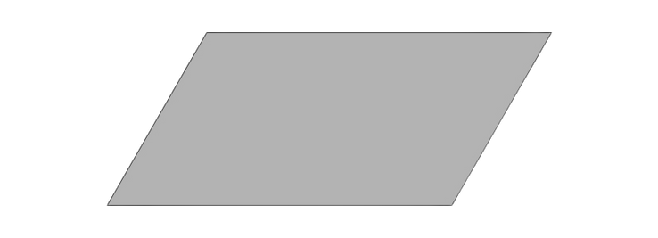
PROJECT 1
Start
Place Aminat at (0,0)
Move right
to (3,0)
Pick the flower
Move down
to (3,2)
Plant the flower
Move right
to (4,2)
Stop
Remove Aminat at (4,2)

Slide 3
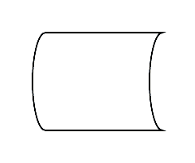

PROJECT 2
Start
List of employees
Input name of employee
Is the name in the list?
NO
Print kindly leave
YES
Print welcome
Stop

Slide 4
PROJECT 3
Start
Input Location
Input weight
Is the location PAU?
Print price is 2000
YES
Is the weight less than 10kg?
NO
YES
Print price is 1500
NO
Is the location
EPE?
Print price is 5000
YES
Is the weight less than 10kg?
NO
YES
Print price is 4000
NO
Stop

